Slide 1
RTU HACKATHON #ITOUT
Team:
Hardik Jain(leader) Deepak Kumar
Laveesh Gupta Nitisha Agarwal
Kanik Vijay Gourav Sharma

Slide 2
Problem Statement:
NOBROKER :
Design a machine learning algorithm to predict the rent of the property . Given a new property our algorithm should be able to predict a rent of the property

Slide 3
Solution:
A Machine Learning Algorithm to find out the attributes on which the rent of a property depends the most and train the model in such a way that it can predict the rent of a new property accurately with minimum number of inputs from the user.

Slide 4
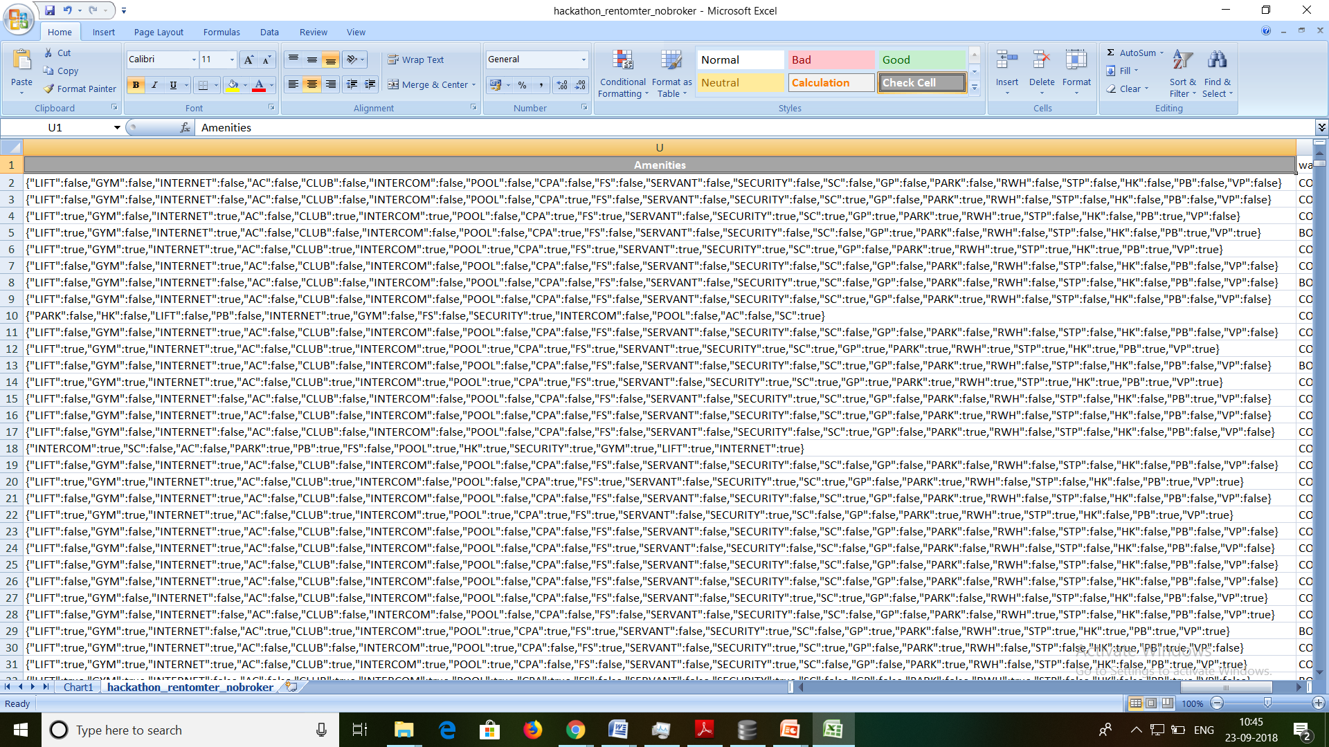
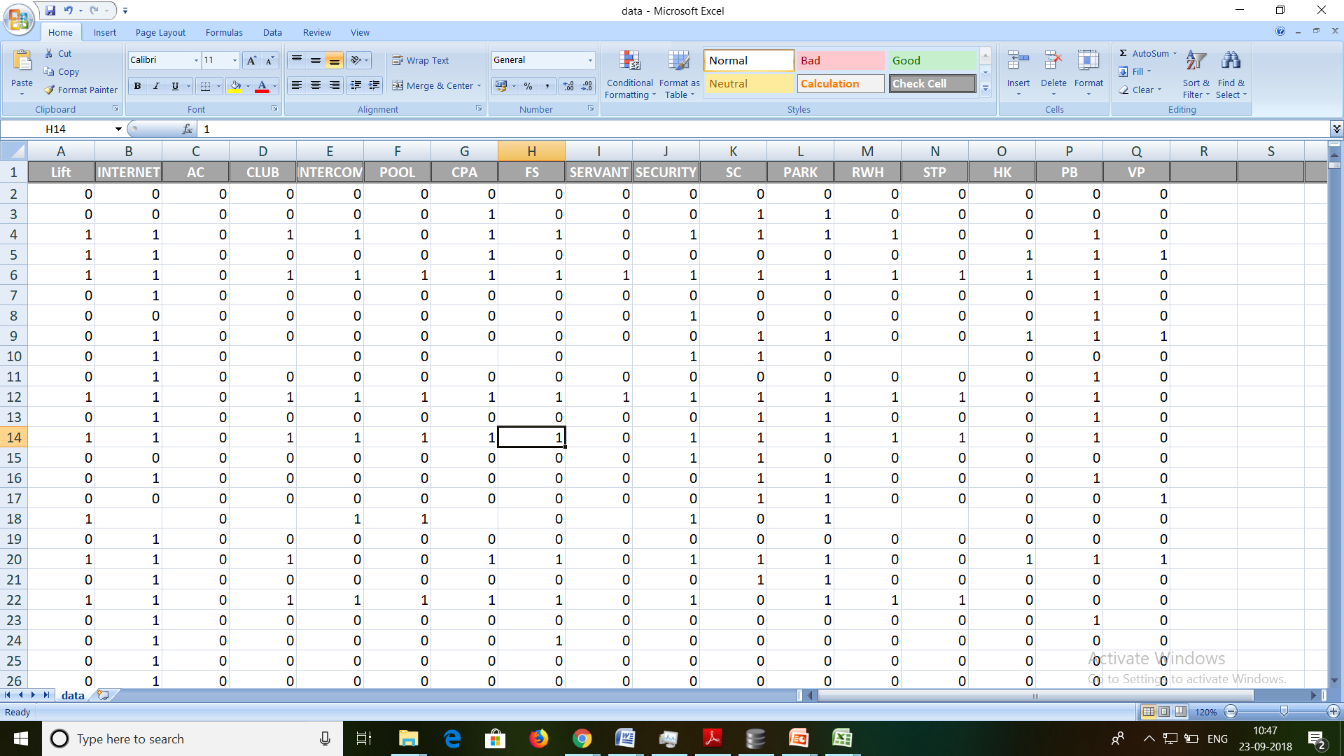
Processing Stage
Data Pre-processing :
After
Preprocessing
Before
Preprocessing

Slide 5
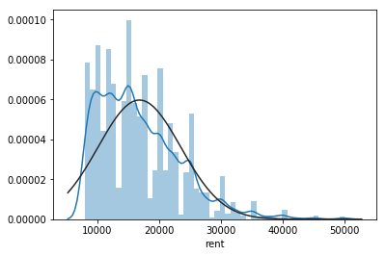
Output of algorithm:
Analysing the
Test variable data

Slide 6
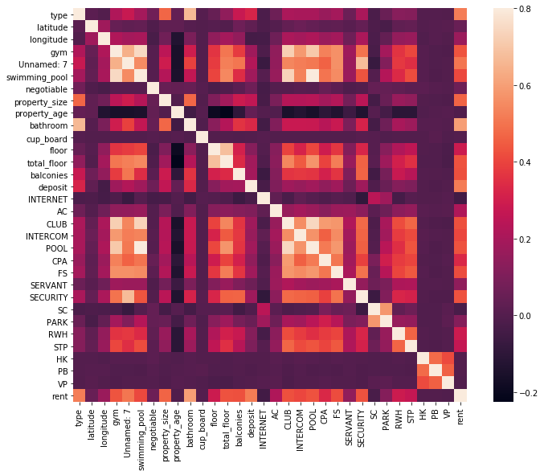
Multivariable analysis

Slide 7
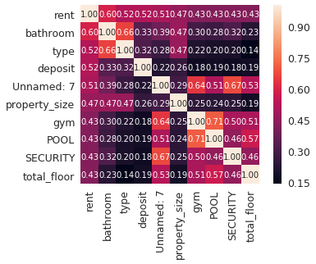
Top - 9 heat map ( showing us the 9 variables on which our RENT relay most )
Serial Number | Correlated Feature
1 | Bathroom
2 | Type(x-BHK)
3 | Deposit
4 | Lift
5 | Property Size
6 | Gym
7 | Pool
8 | Security
9 | Total-Floor

Slide 8
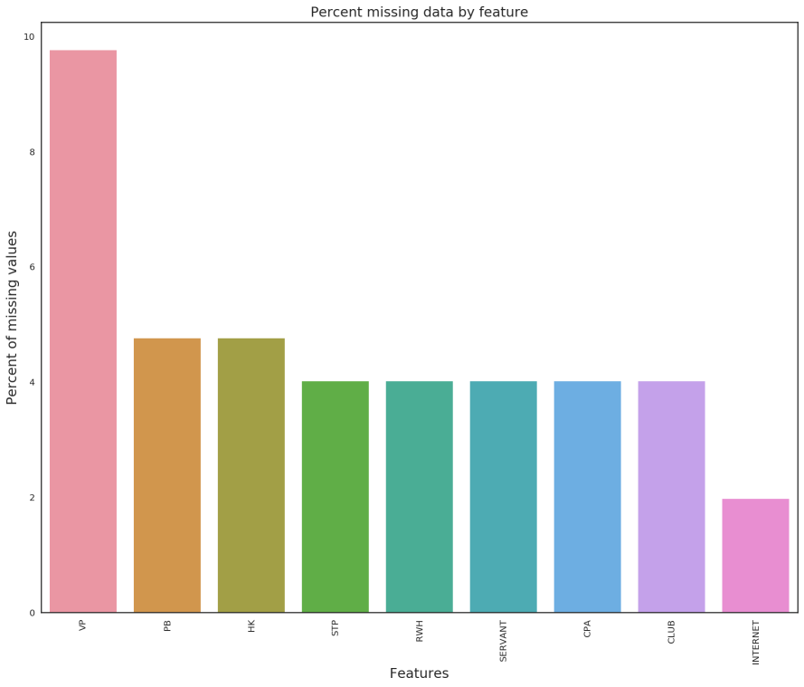
Missing Data By feature

Slide 9
Why us??
Fast
response
Save money
&
time
Easy to
Manage
resources

Slide 10
Future scope:
Create a more user-friendly UI for users
Increase the Accuracy of the model

Slide 11
Thank you ……

